Slide 1
Translation of Axes

Slide 2
SPECIFIC OBJECTIVES:
At the end of the lesson, the student is expected to be able to:
• translate coordinate axes.
• find new coordinates after translation.
• find new equation if the origin is translated to a given point..
• simplify the equations by translation of axes.
• graph the transformed equation.

Slide 3
Definition: Translation of Axes
Consider a transformation in which the new axes are parallel to the original axes and similarly directed. Translation of axes is related to performing two geometric transformations: a horizontal shift and a vertical shift. Hence the new axes can be obtained by shifting the old axes h units horizontally and k units vertically while keeping their directions unchanged.
Let x and y stand for the coordinates of any point P when referred to the old axes, and x’ and y’ the coordinates of P with respect to the new axes. Then x = x’ + h and y = y’ + k.

Slide 4
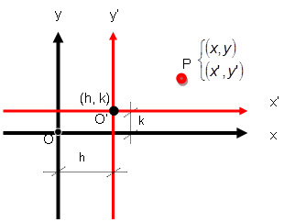

Slide 5
Rotation of Axes Identification of a Conic

Slide 6
SPECIFIC OBJECTIVES:
At the end of the lesson, the student is expected to be able to:
• transform an equation by rotation of axes.
• simplify the equations by rotation of axes.
• identify a conic given an equation.
• graph the transformed equation.

Slide 7
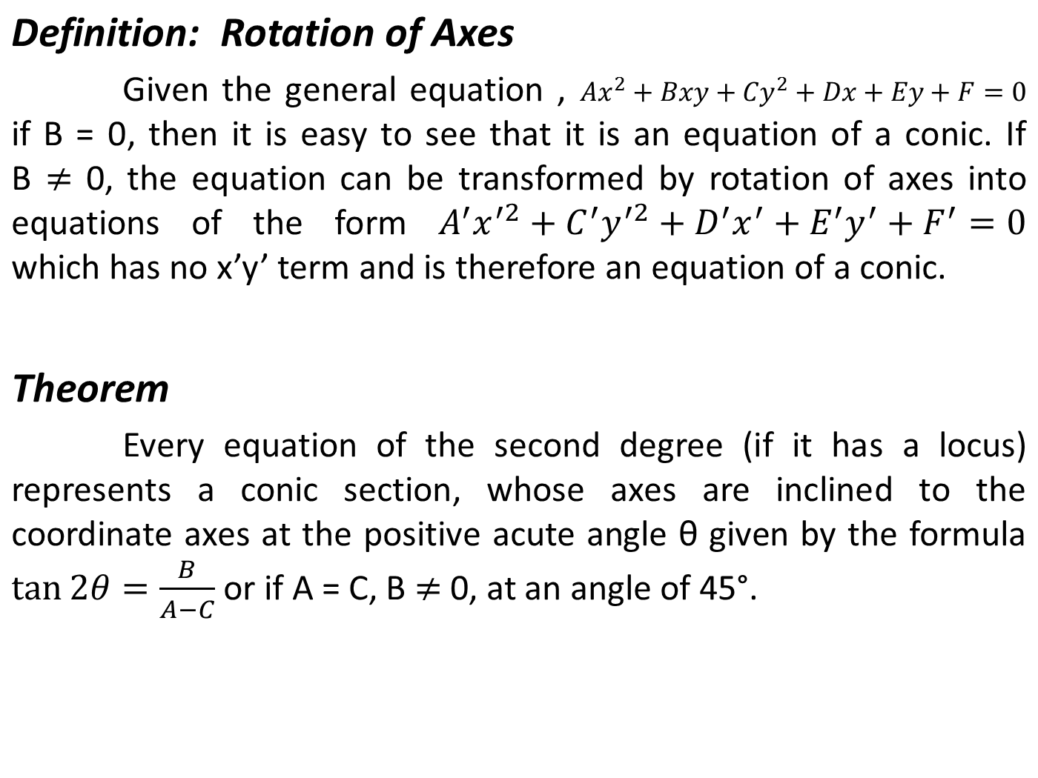

Slide 8
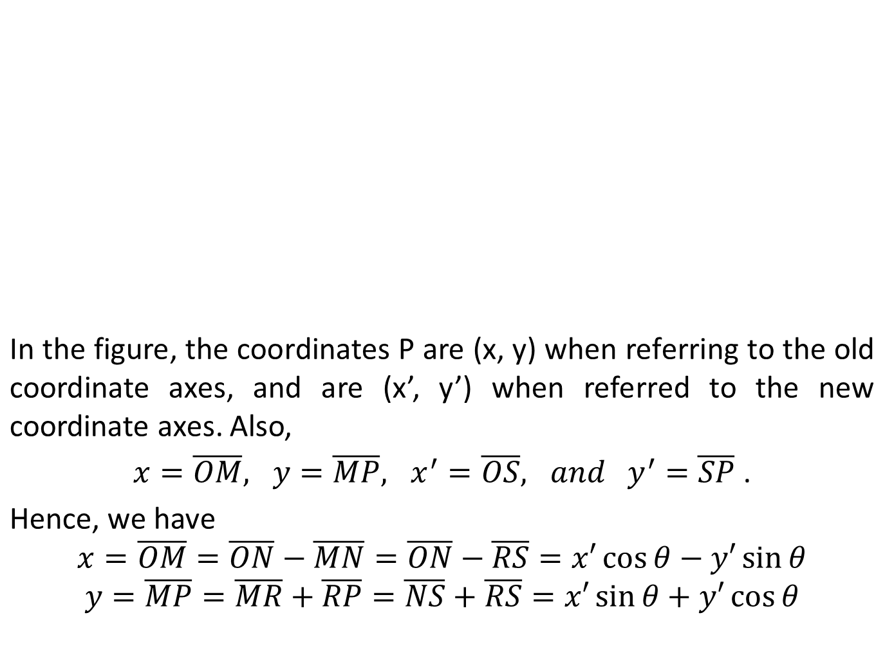
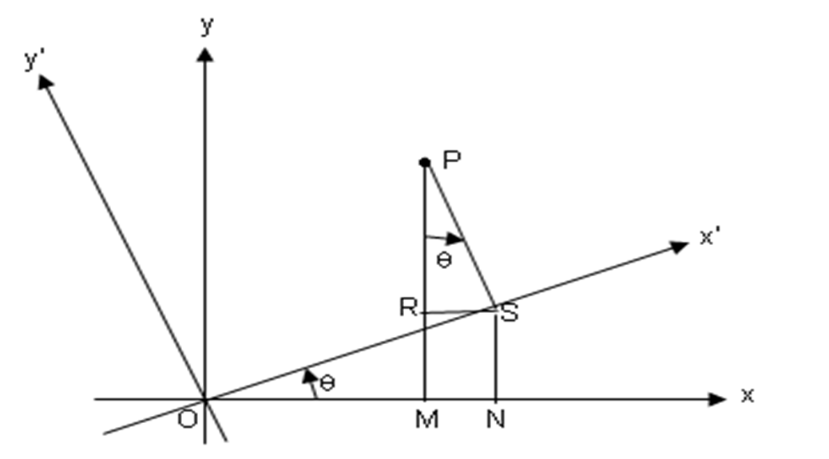

Slide 9
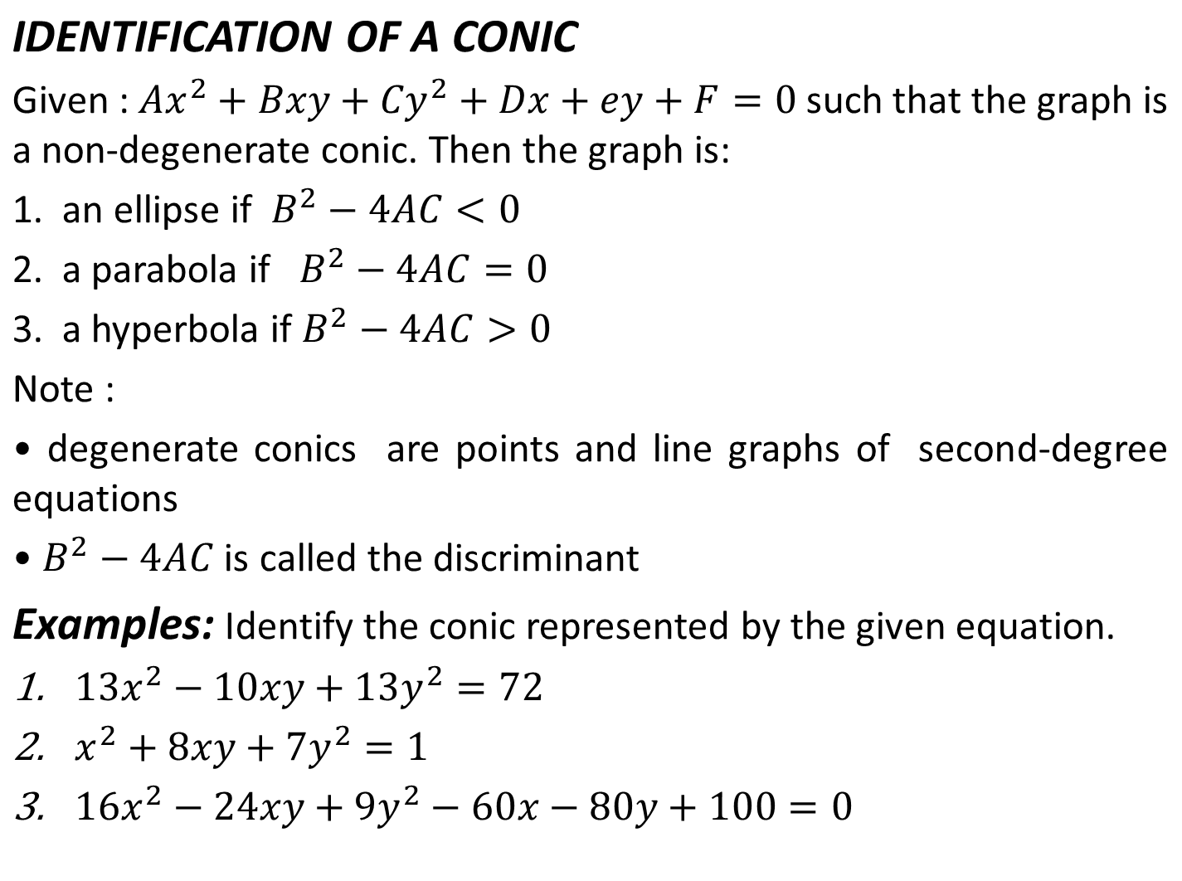

Slide 10
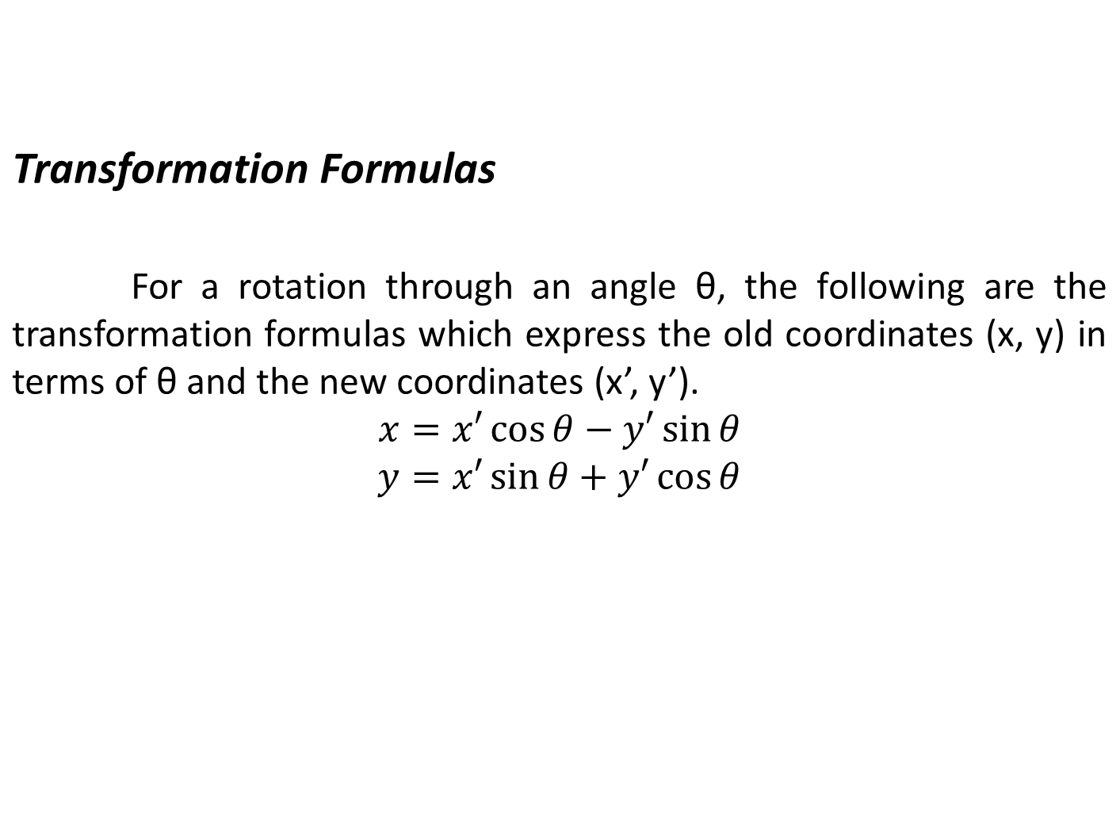

Slide 11
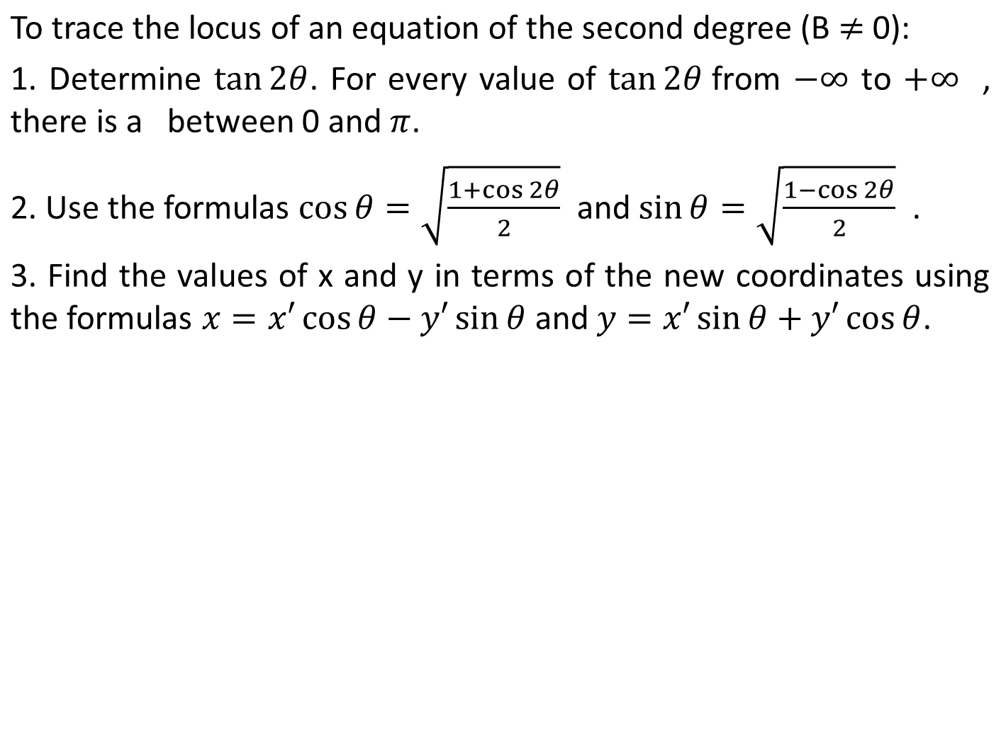
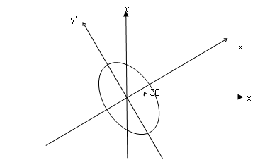

Slide 12
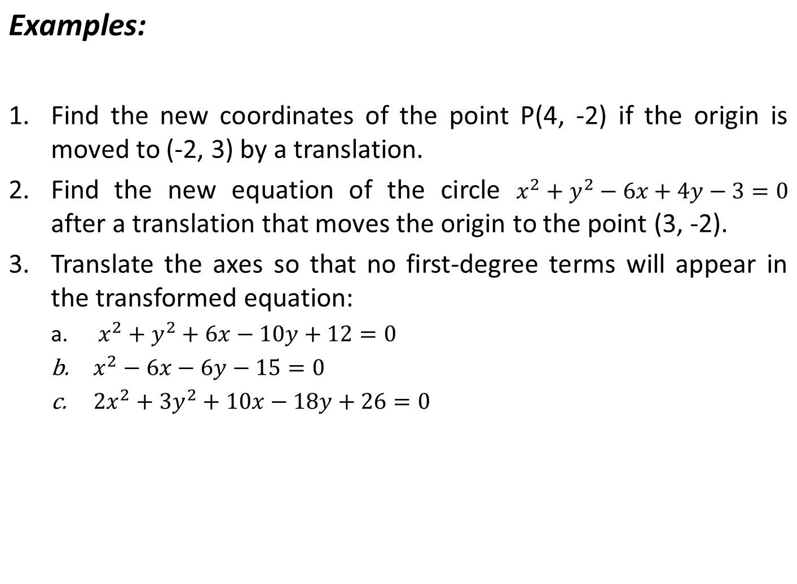

Slide 13
Examples:
Find the coordinates of P(3, 4) after a rotation of an angle = 60⁰.
Transform the equation by rotating axes through 45º.

Slide 14

Seatwork no. 5
Sketch and discuss the ellipse 4x² + 3y² - 16x + 18y + 43 =0
Determine the new equation of
if the origin is translated to the point (5, -3).
By a translation of axes, simplify x² – 2x + 8y – 15 = 0.
Find a new representation of the given after rotating through the given angle:
x² + 4xy – 2y² – 6 = 0, Ө = Arctan ½
x² – 3xy + y² + 5 = 0, Ө = 30⁰

Slide 15
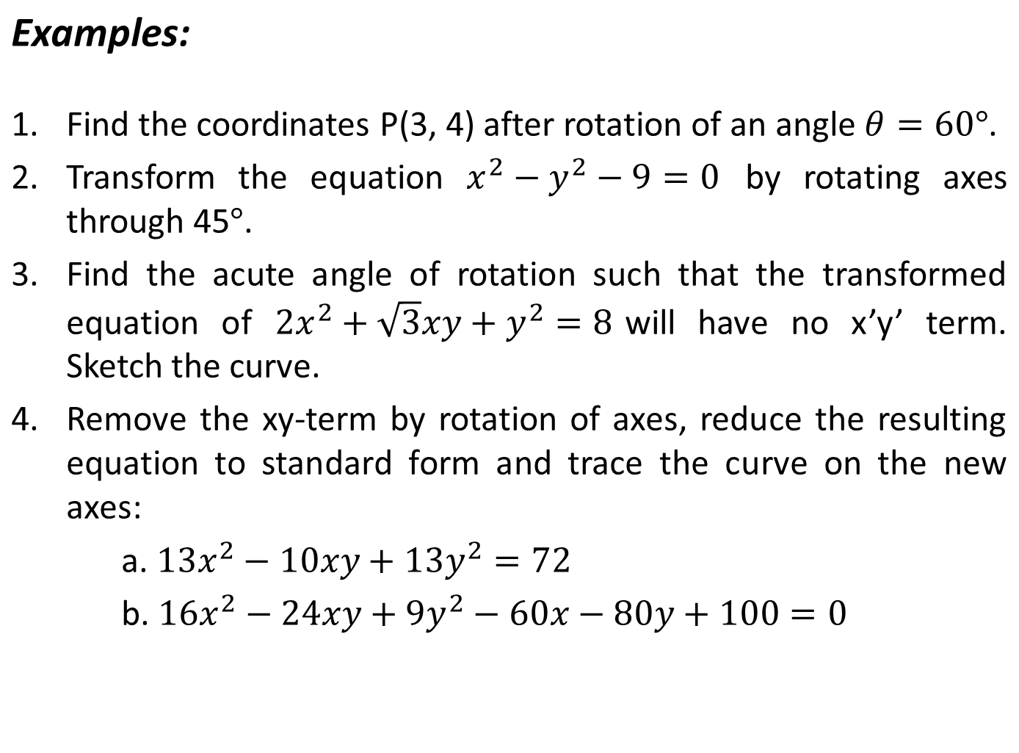

Slide 16
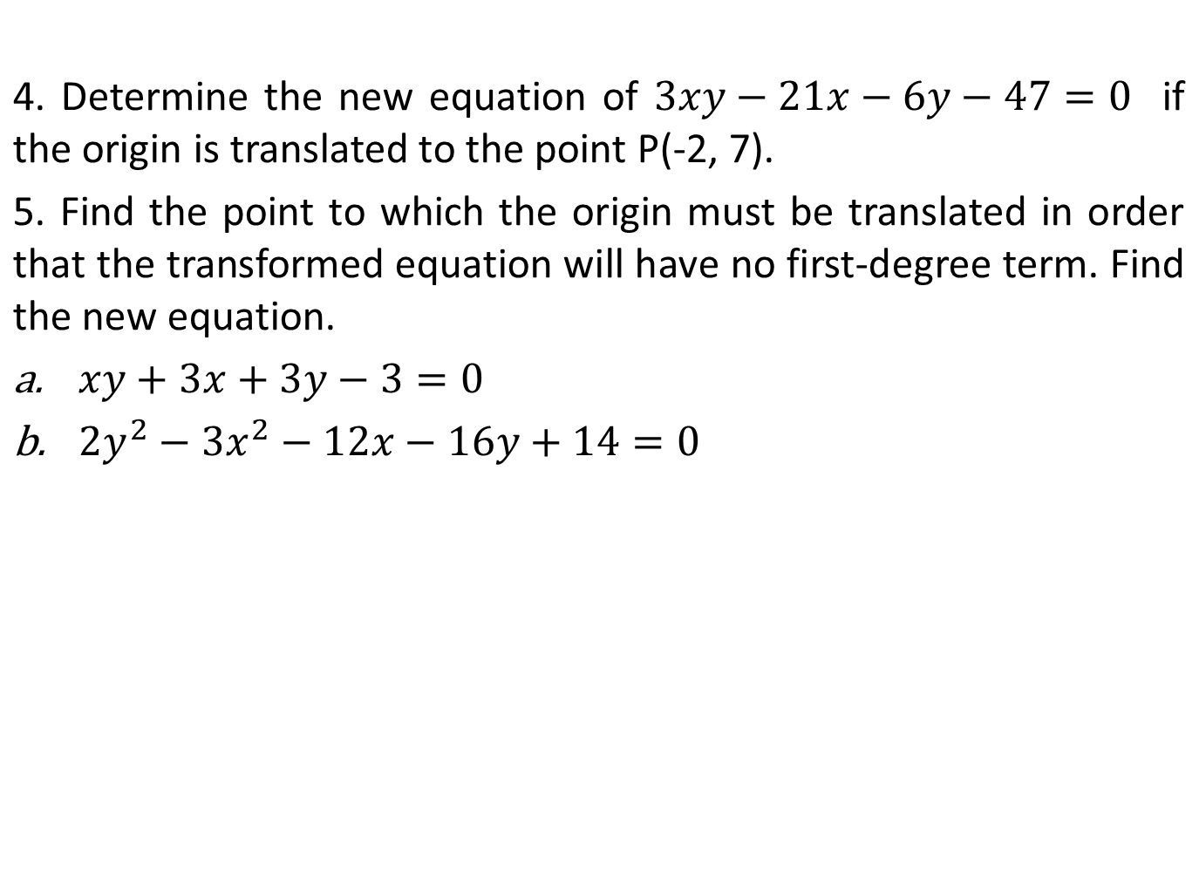

Slide 17
End of Discussion

